Slide 1
Creating a protected area and handling user authentication with a credential form
Notes:
[Mandatory Slide] This would be the introduction slide of the topic that you are covering in this subsection.
When this slide plays, you could talk about the main aim that we’d be covering in this video.

Slide 2
In this Video, we are going to take a look at…
The user authentication workflow
Code sample
Notes:
[Mandatory Slide]
Before the start of the video, we’d like to highlight what are important topics or pointers that we’d be covering in this video. This slide would immediately follow the intro/name slide. This would just be say 2-3 points for the viewers to know what they are getting into.

Slide 3
The user authentication workflow (1/2)
Authentication is the process of confirming the identity of an entity (eg. user, program) so that access to the functionalities of a system can be granted
The entity provides some information (credentials) to the system in order to prove their identity
For web apps, usually a registration/signup/enrollment process is issued so that the system releases credentials to the users
Notes:
[Mandatory Slide]
Before the start of the video, we’d like to highlight what are important topics or pointers that we’d be covering in this video. This slide would immediately follow the intro/name slide. This would just be say 2-3 points for the viewers to know what they are getting into.

Slide 4
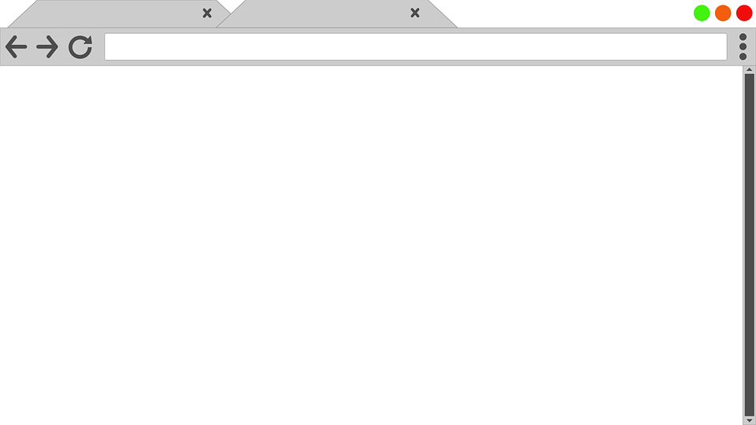




The user authentication workflow (2/2)
ID PROVIDER
HTML FORM
AUTH OK, REDIRECT
?
USERNAME
AUTH KO, SHOW ERR
PASSWORD
BROWSER
SYSTEM
HTTP POST username + password
Notes:
[Mandatory Slide]
Before the start of the video, we’d like to highlight what are important topics or pointers that we’d be covering in this video. This slide would immediately follow the intro/name slide. This would just be say 2-3 points for the viewers to know what they are getting into.

Slide 5
Code Sample
Notes:
Something that needs to grab the viewers attention!!

Slide 6
Summary
The user authentication workflow
Code sample
Notes:
[Mandatory Slide]
Before the start of the video, we’d like to highlight what are important topics or pointers that we’d be covering in this video. This slide would immediately follow the intro/name slide. This would just be say 2-3 points for the viewers to know what they are getting into.

Slide 7
Testing the website
Next Video
Notes:
[Mandatory Slide]
Here the name of the next video needs to be mentioned. The narration as you guessed it would be just letting the viewer know exactly where we are at and what we’d be taking over next! ☺

